Slide 1
E-commerce Analytics Dashboard
Satyam Nathoo
i

Slide 2
Objective
E-commerce (electronic commerce) is the buying and selling of goods and services, or the transmitting of funds or data, over an electronic network, primarily the internet. These business transactions occur either as business-to-business (B2B), business-to-consumer (B2C), consumer-to-consumer or consumer-to-business.
The Analytics team of an Online E-Commerce Company wants to design a Sales dashboard to analyze the sales based on various product categories. The company wants to add user control for product categories, so users can select a category and can see the trend month-wise and product-wise accordingly. The Analytics team also wants to create a histogram to analyze the number of shipping days. The company’s database keeps track of the following data fields: Brand Name, Company Name, Disease Medical Use, Invoice date, Company code, Ship-to-Country, Ship-to-Country Full Name, Sold-to party- Code, Sold-to party Country, Sold-to party Country Full Name.me, Delivery Plant, Payment terms, External Agent, Sales quantity, Price TC /Kg, Revenue, External commissions, Month.
4

Slide 3

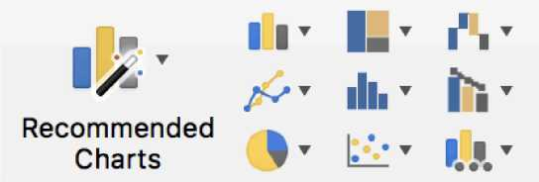
Tools used
Business Intelligence tools and features such as MS Excel 2016,Formulas,Charts are used to build the whole framework.
6

Slide 4
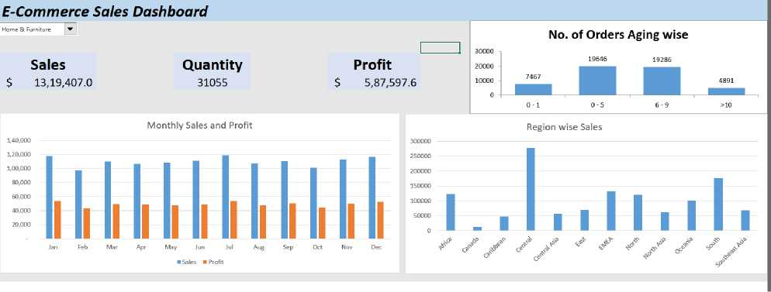
Analytical Dashboard
KPIs (Key Performance Indicators)
Key indicators displaying a summary of the Sales & Profit and its relationship with different metrics
1. Impact of Product Categories on Sales,Quantity and Profit
2. Impact of Year/Month on Sales & Profit.
3. Influence of Region parameter on Sales.
4. Influence of No. of Orders Aging wise parameter on Sales
9

Slide 5
Deployment
Prioritizing data and analytics couldn’t come at a better time.
Your company, no matter what size, is already collecting data and most likely analyzing just a portion of it to solve business problems, gain competitive advantages, and drive enterprise transformation.
With the explosive growth of enterprise data, database technologies, and the high demand for analytical skills, today’s most effective IT organizations have shifted their focus to enabling self-service by developing Automated Dashboards in Excel using Macros and VBA at scale, as well as organizing and unifying disparate sources of data for business users and experts alike to author and consume content.
10

